Slide 1

SmartSwitch – High Availability Overview
Riff Jiang

Slide 2
Outline
What is HA?
HA scope and ENI pair placement
Network setup for HA and traffic forwarding
Control plane overview and ENI programming model
HA state machine and operations

Slide 3

HA for ENI

Slide 4
What is HA (High Availability)?
A single switch / DPU goes down or when a network failure happens, it will not:
Kill all the traffic for an ENI (vNIC).
Causing all existing flows to be dropped.
Goals: https://github.com/sonic-net/DASH/blob/main/documentation/high-avail/high-availability-and-scale.md.
0 downtime on planned switchover.
<2 sec downtime on unplanned failover to standalone setup for each ENI.
Ability to resume connections in the event of both planned and unplanned failover.
After both planned and unplanned failover and recovery, the flow on all DPUs will be aligned.
…

Slide 5
So, what is HA?
Flow HA: Each ENI will be backed up by 2 DPUs, so flows can be replicated between them, and won’t be dropped when one DPU/Switch is having problem.
Data path HA: Handles network failures and reduce the chance of packet drops.

Slide 6
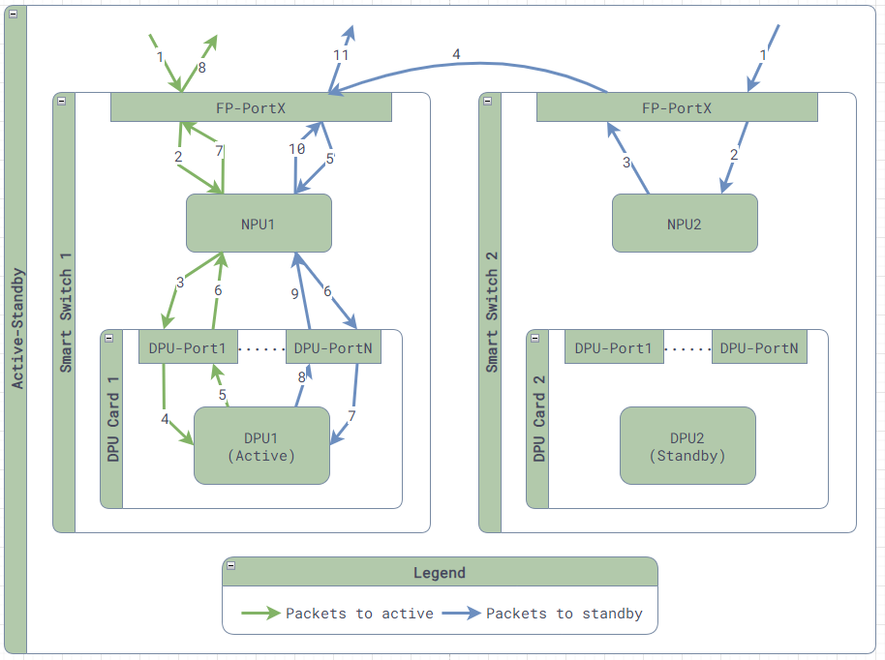
ENI Flow HA – Active/Standby
Each ENI must be placed in 2 DPUs from 2 different switch forming a HA pair.
1 DPU serves as active and making flow decisions, while the other DPU serves as standby, acting as a flow storage, only accepting flows replicated from active.
In steady state, all flows will be inline sync’ed from active to standby. When a DPU rejoins the HA pair, we bulk sync the flows.
When the active DPU runs into issues, we will failover the active, make the standby the new active, and switch over the traffic to avoid further impact.

Slide 7
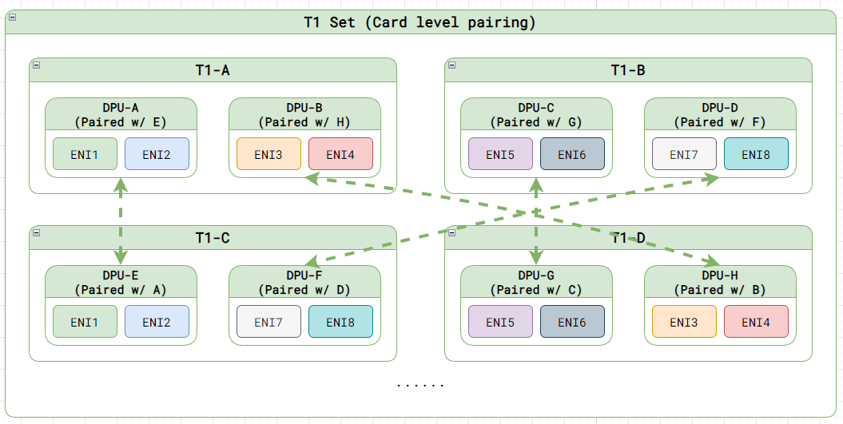
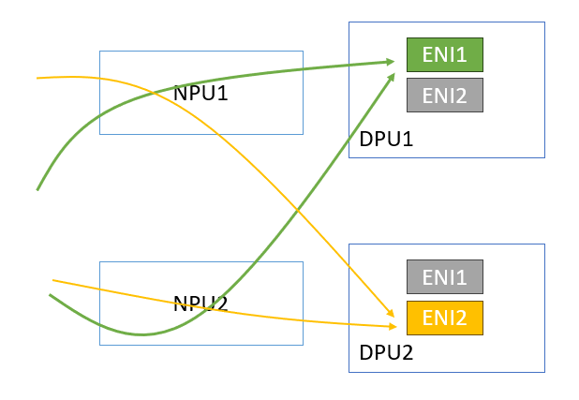
ENIs in SmartSwitch
Card-level ENI pairing
ENI-level Active/Standby

Slide 8
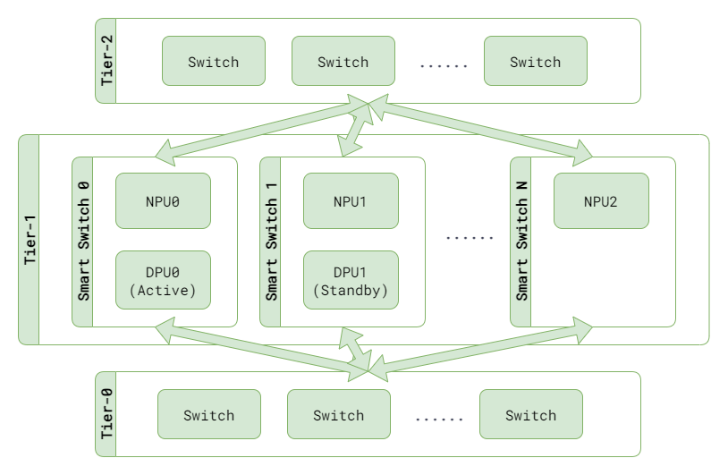
Data Path HA
All T1s advertise the same VIPs.
When a T1 receives a packet for an ENI, it forward the packet directly to the active DPU using a VxLan tunnel.
Handles single switch failure and no more waiting for BGP reconcile.

Slide 9
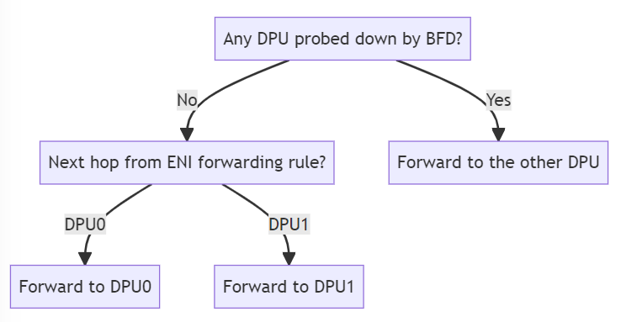
Controlling Traffic Forwarding
Card-level NPU-to-DPU probing
NPU sending BFD probe to DPU to check if DPU is alive or not.
When probed down, NPU will stop forwarding all traffic to this DPU.
When probed up, NPU will respect the ENI-level traffic control.
ENI-level NPU-to-DPU traffic control
Explicitly setting up the next hop to the current active side.

Slide 10

HA Control Plane Overview

Slide 11
Control Plane Overview
Upstream Service (SDN controller):
Decide ENI placement and pairing.
Decide preferred active ENI placement.
Decide desired HA states under planned events, such as planned switchover, planned shutdown for upgrades, evening traffic and etc.
Triggering HA operations for manual live site mitigations.
SmartSwitch:
Drive the HA state machine transitions.
Report every ENI HA state change and reasons, so upstream service knows what is happening and can make decisions for planned events.
Handle HA related requests from upstream service.
Monitor and handle unplanned events, and trigger defined mitigations, such as driving to standalone setup.

Slide 12
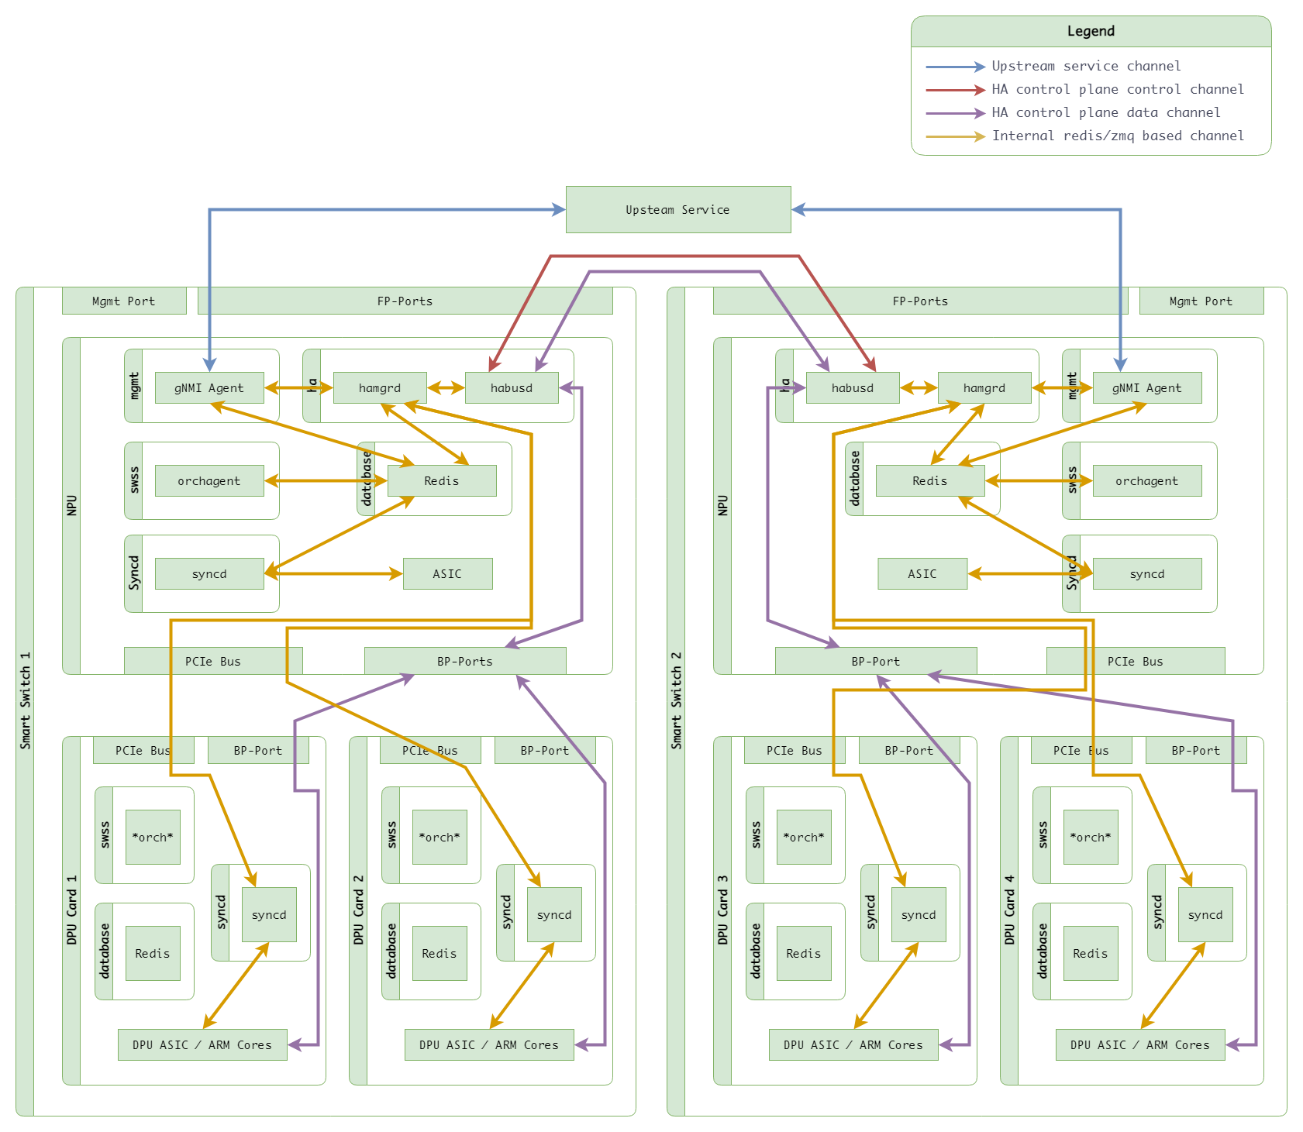
HA communication channels
Upstream Service Channel
Goal state programming
HA Control Plane Channels (gRPC)
HA Control Plane Control Channel
Driving HA state transitions
Updating ENI traffic forwarding rules
Guaranteed to work within a bounded time
HA Control Plane Data Channel
Bulk sync
Data Plane Channel (Tunnel)
Inline sync

Slide 13
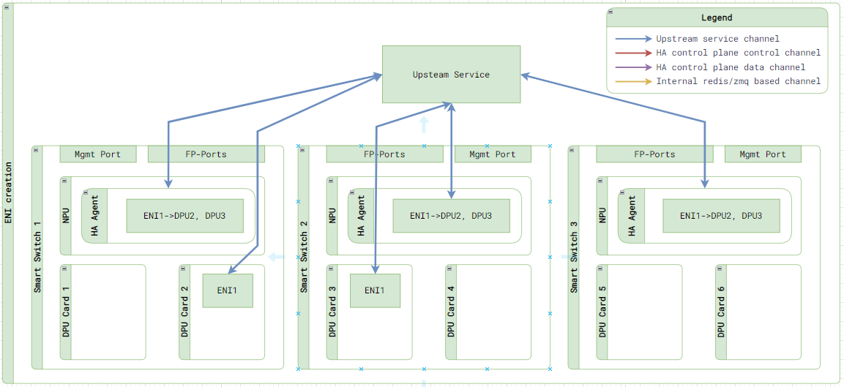
ENI Creation (Step 1)
Upstream service will first decide where to put the new ENI and form the HA set.
Upstream service calls northbound interface and programs the following things on each SmartSwitch independently
Create the ENI on selected DPUs with its peer information, so we can form a HA set.
Program traffic forwarding rules to all the switches that will receive the traffic.

Slide 14
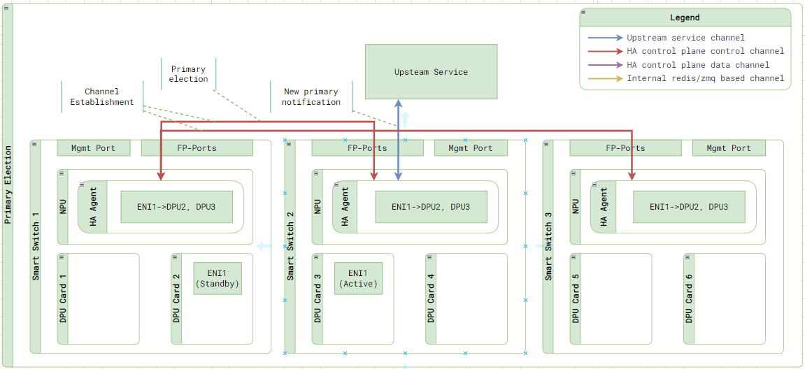
ENI Creation (Step 2)
Once programming is finished, the 2 ENIs will start forming the HA pair with:
Control plane channels created
New active elected with the instruction that is specified by upstream service.
Once the new primary is elected, SmartSwitch will notify the upstream service that the primary is selected.

Slide 15
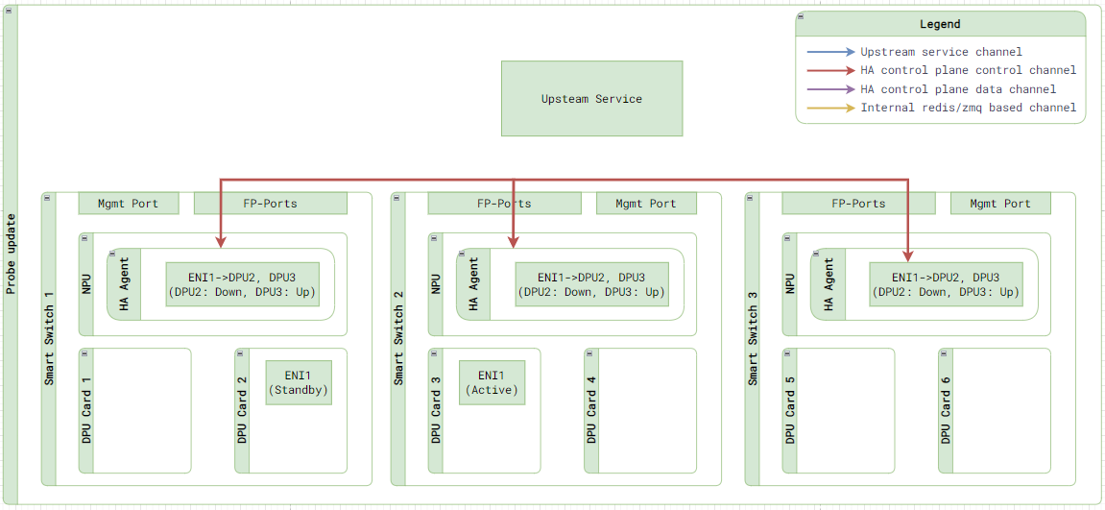
ENI Creation (Step 3)
The primary election process will also update the probe state of all ENIs, making sure the traffic is forwarded to the right DPU.

Slide 16
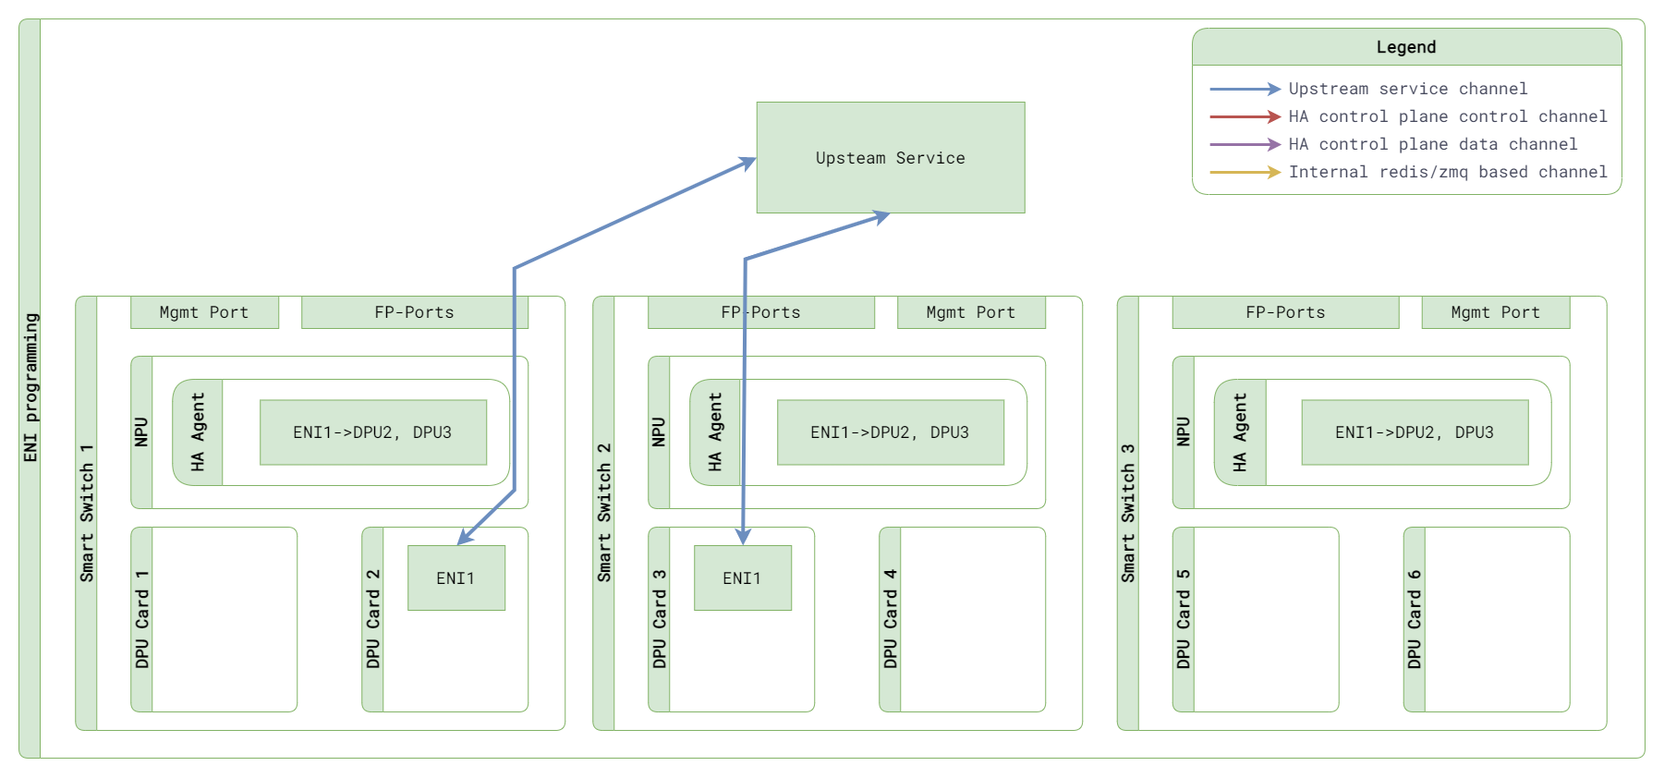
ENI Programming
For all future goal state update, upstream service will program both ENI independently.

Slide 17
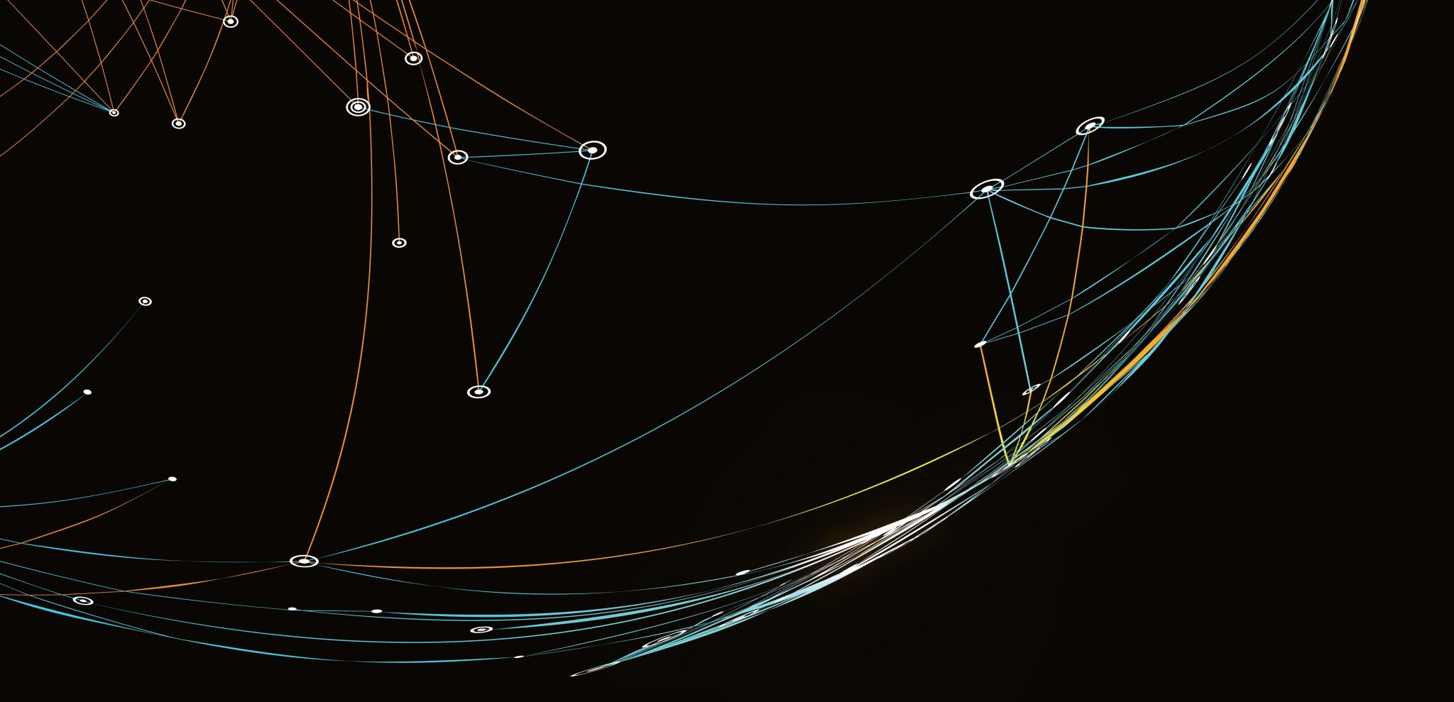
HA State Machine and Operations

Slide 18
Planned Events vs Unplanned Events
Planned events:
ENI launch, Switchover, Shutdown, Migration, etc.
Goal: 0 down time. Avoid bulk sync / flow merge as long as we can.
Initiated from and approved by upstream service.
Unplanned events:
Network failure, DPU/NPU/PCIe failure.
Goal: <2s failover to standalone setup.
Initiated and driven from SmartSwitch w/ predefined config from upstream service.

Slide 19
HA State Machine
Key states: Dead, Active, Standby, Standalone
Other transition states can be found in appendix.
State | Definition | Receive Traffic from NPU? | Make decision? | Handling old flow? | Respond flow sync? | Init flow sync? | Init Bulk sync?
Dead | HA participant is just getting created, and not connected yet. | No | Drop | Drop | No | No | No
Active | Connected to pair and act as decision maker. | Yes | Yes | Yes | No | Yes | Yes
Standby | Connected to pair and act as backup flow store. | No | Tunneled to pair | Tunneled to pair | Yes | No | No
Standalone | Heartbeat to pair is lost. Acting like a standalone setup. | Yes | Yes | Yes | Yes | No | No

Slide 20
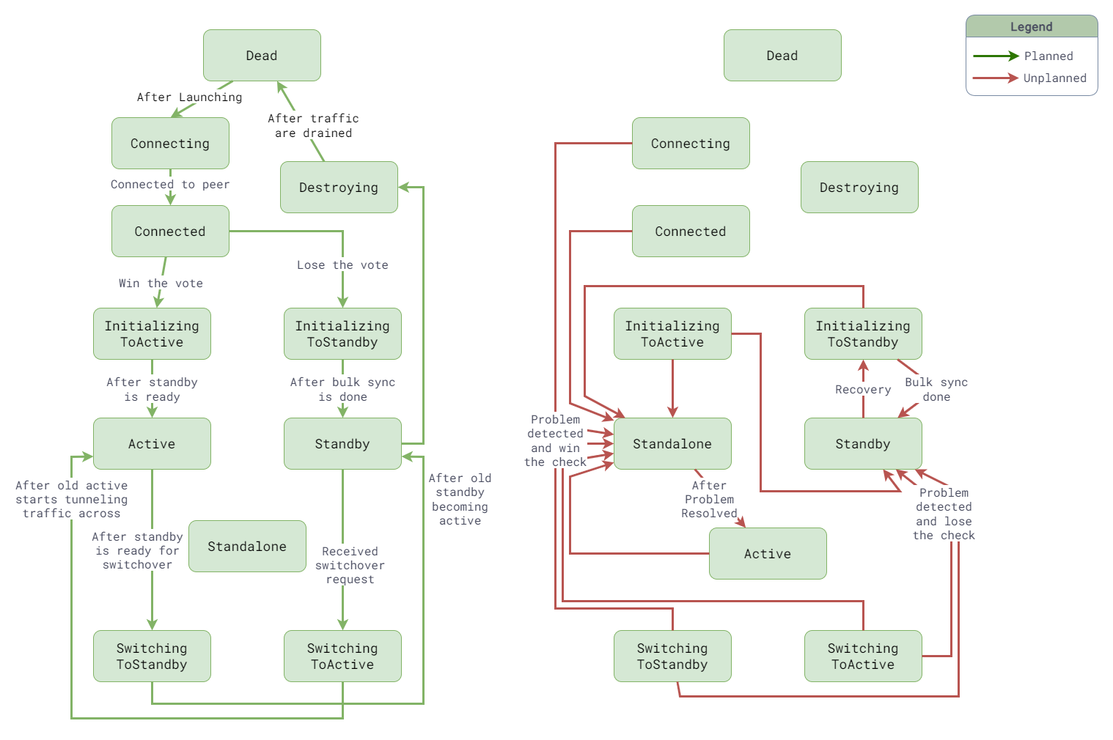
HA State Transition

Slide 21
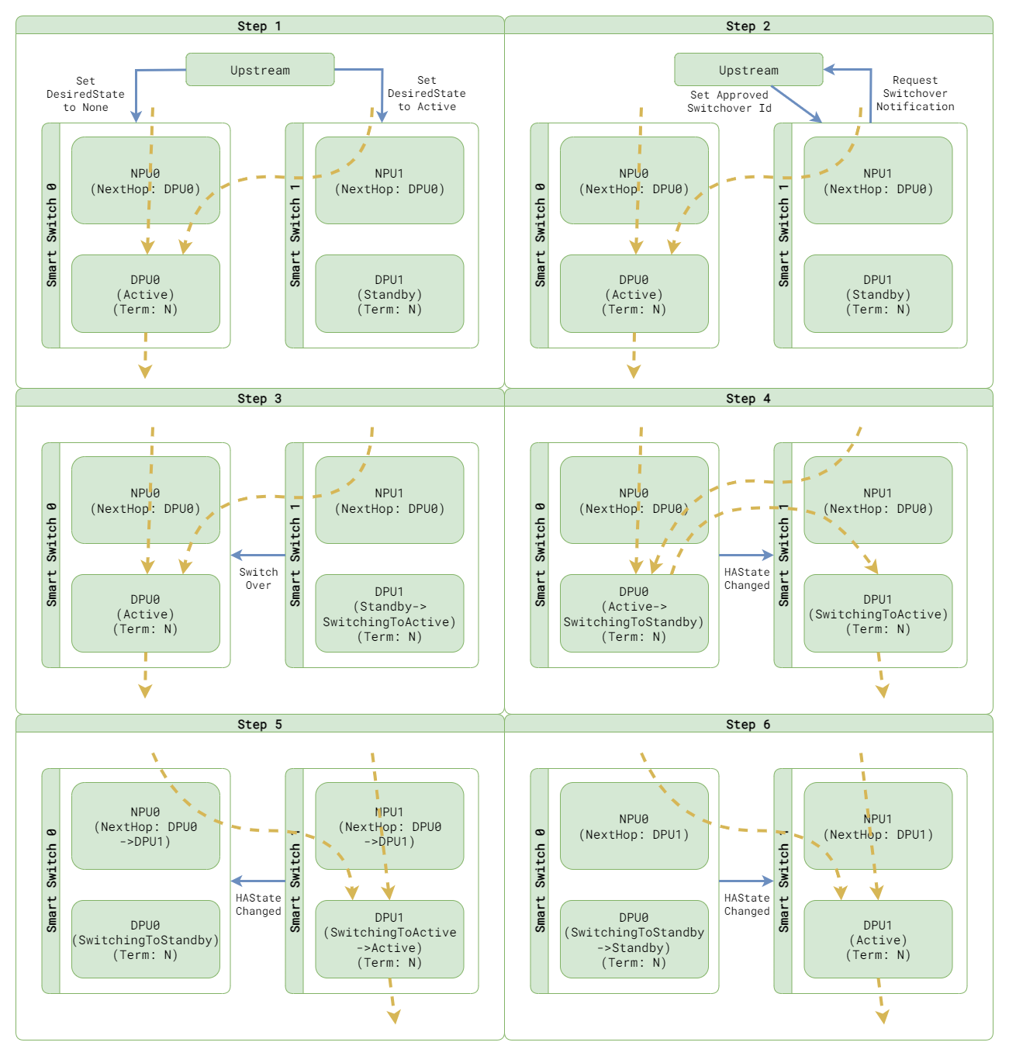
Planned Switchover
Upstream initiates the operation by setting the desired state.
SmartSwitch requests upstream for switchover, in which upstream ensures the state is in steady state and policy on both side matches.
Once approved, SmartSwitch drives the state transition and update the ENI-level traffic control to desired state.
Switchover starts from a standby node.

Slide 22
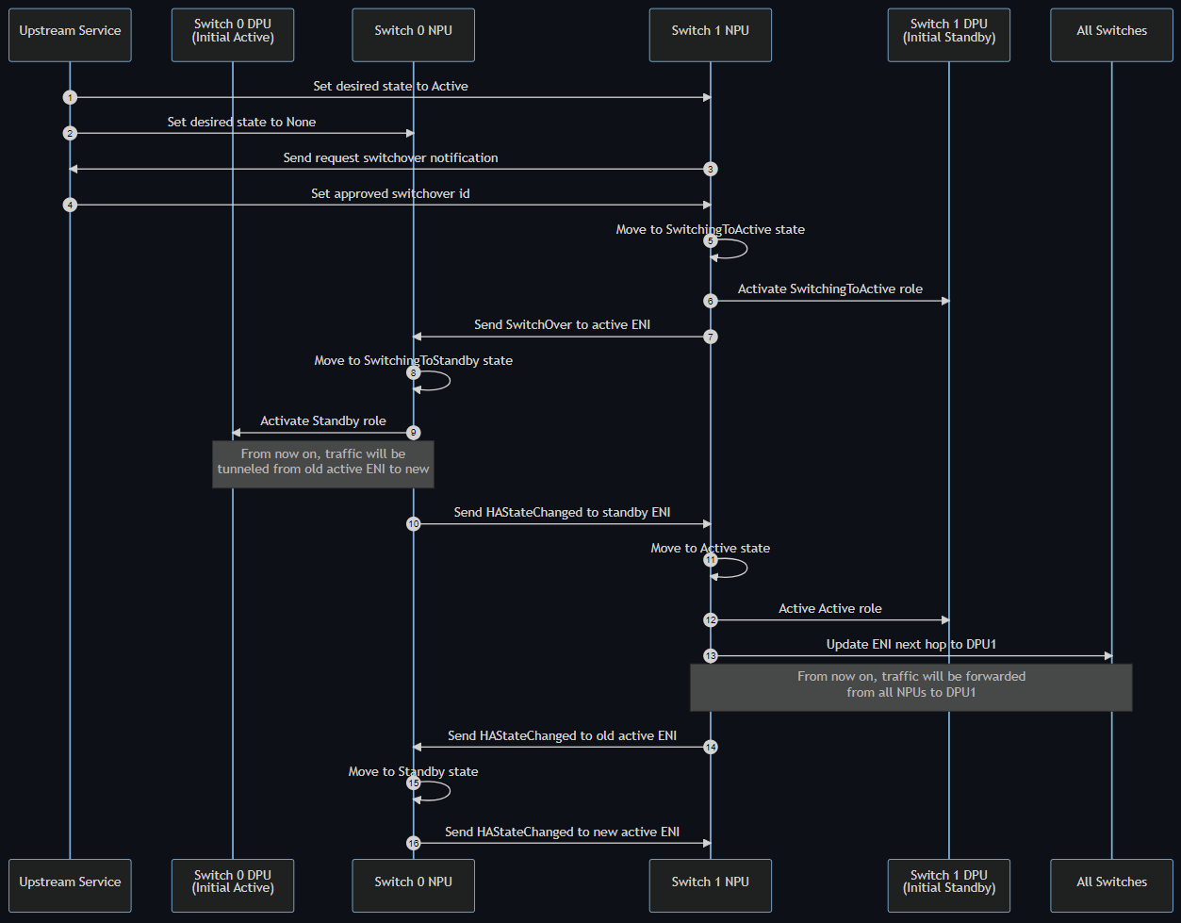
Planned Switchover – Seq. Diagram

Slide 23
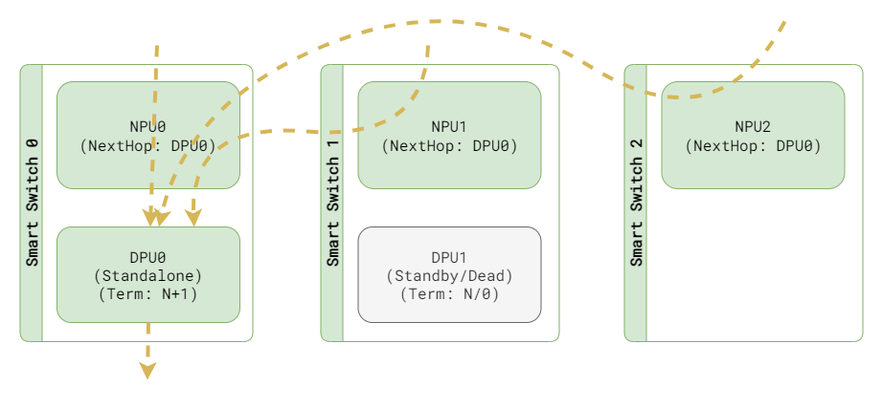
Unplanned events vs Standalone setup
Network interruption will be unavoidable.
Best Effort: Reduce the chance of dropping packet by stopping flow replication. No solution is going to be guaranteed to be perfect.
“Standalone-Standby/Dead” pair to avoid 2 deciders / Brain split.
Card-level standalone setup - All ENIs will failover together. This is due to bulk sync limitation today, but we are going towards ENI level.
If any unplanned events last long, fire alerts.

Slide 24
Step 1 - Triggers
Problem | Trigger | Resolve signal
Peer shutdown | Planned shutdown request | HAStateUpdate with Connected state
Peer DPU lost | Peer lost SAI notification | Peer connected SAI notification
Peer DPU dead | HAStateUpdate with dead peer | HAStateUpdate with non-dead peer
High data plane packet drop rate | ENI-level data plane counters | ENI-level data plane counters
Manual Pinned | ENI-level DPU isolation | Isolation removed
Card pinned to standalone | Card pinned to standalone | Pinning removed

Slide 25
Step 2 - Vote
Merge the signals from ENI level to card level first
Things to check:
Already in standalone state
Local DPU health signals (Covers DPU/Switch hardware failures)
Send request to pair to start voting
Standalone state of the pair
Check if any DPU is manual pinned by DRI. If both pinned, cancel vote and alert.
Use preferred standalone DPU programmed from upstream (Covers data path failures).
ENI-level standalone voting is in omitted here. We can find it in full design doc.

Slide 26
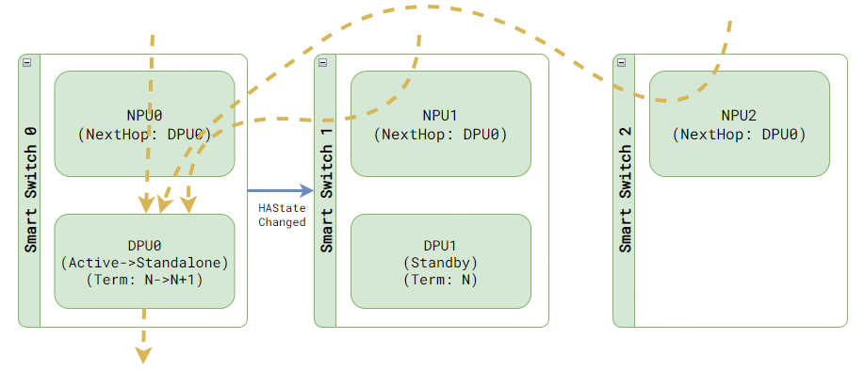
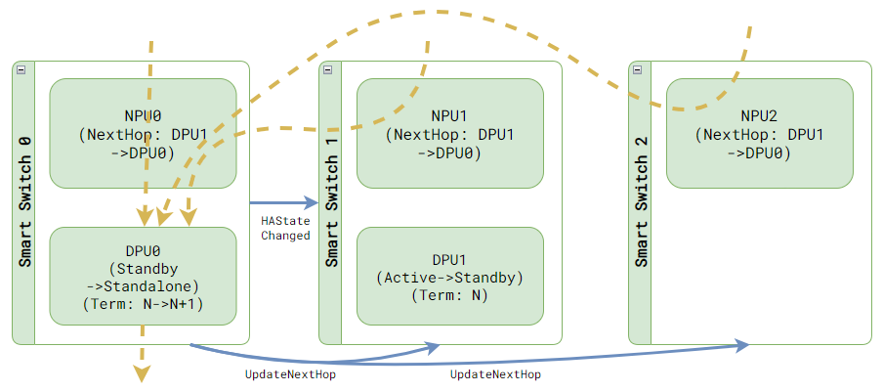
Step 3 – Drive into standalone state
Once vote is done, each ENI’s state will be updated and start to drive on its own.

Slide 27
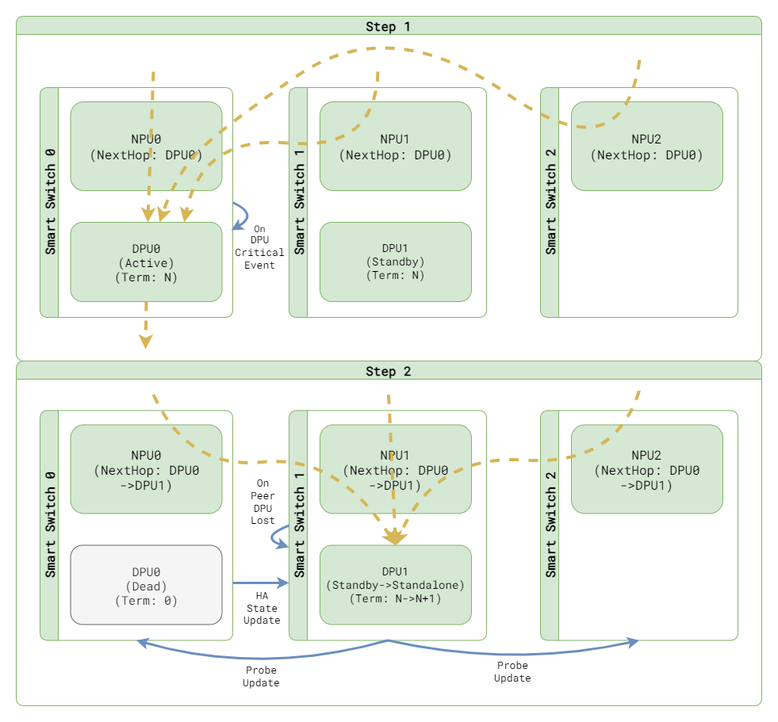
Example – Peer DPU is down
Using “Peer Lost” SAI notification as trigger.
Once detected, we will start voting. This will cause the good side to go into standalone state, which stops flow replication.
Due to card level standalone, other ENIs in standby state will also be moved to standalone state.

Slide 28
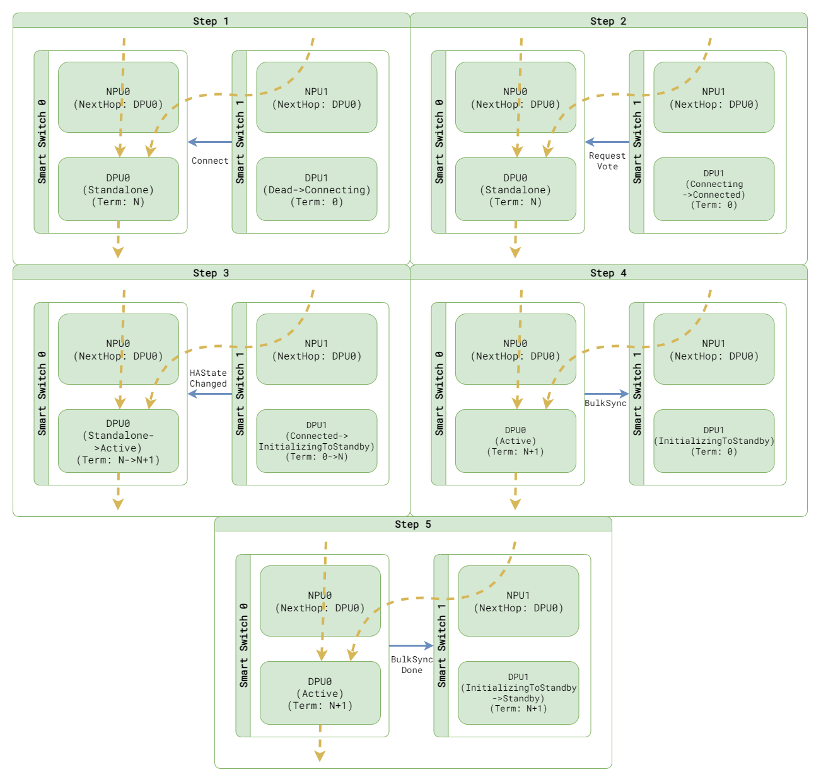
Recover from standalone setup
Bulk sync is used for bring the node to ready again

Slide 29
Term Tracking and Primary Election
Term:
Find the DPU that lives the longest and knows the most on the historical flow changes.
While a DPU can make flow decision, the term increases whenever the inline sync channel is enabled or disabled.
Primary election: Whichever with higher term wins.
It also need to consider other cases to make the algorithm practical, such as ENI not found, Pinned to standalone, ENI is shutting down.
https://github.com/r12f/DASH/blob/user/r12f/ha/documentation/high-avail/smartswitch-ha-hld-proposal.md#83-primary-election

Slide 30
Flow lifetime management
Active rules all, standby always follows.
Inline sync – Connection creation, close or re-simulated.
Batched sync – Flow aged out, bulk sync TCP seq number or flow deletion via SAI APIs.
Bulk sync – When a node rejoins the HA set.

Slide 31
Bulk sync
Perfect sync
Whenever a node becomes active, we increase the flow version (color).
Sync all flows that has lower flow version than current.
Range sync (ENI level only)
Idea is only sync the flow that is not sync’ed
ImpactStart = Whenever inline flow sync channel breaks
ImpactEnd = Whenever inline flow sync channel reestablished
While a DPU can make flow decision, whenever the inline sync channel is enabled or disabled, we increases the flow version.
When inline sync channel is disabled, track all existing flow deletions.
Sync only the flows that has the flow version when inline sync channel is disabled.

Slide 32
Having problem talking to upstream?
Policy will become stale gradually.
HA will continue to function and handle unplanned events.
As long as upstream can talk to one side of DPU, we can use pin the reachable side to standalone to make the policy update working again.
If both sides are down, then policy will not be updated. Everything will freeze as it is. (No planned operations and no policy updates).

Slide 33
References
SmartSwitch HA High Level Design doc: https://github.com/r12f/SONiC/blob/user/r12f/ha/doc/smart-switch/high-availability/smart-switch-ha-hld.md.
DASH High Level Design doc: https://github.com/sonic-net/DASH/blob/main/documentation/general/dash-high-level-design.md.
DASH scale design: https://github.com/sonic-net/DASH/blob/main/documentation/general/dash-sonic-hld.md.

Slide 34
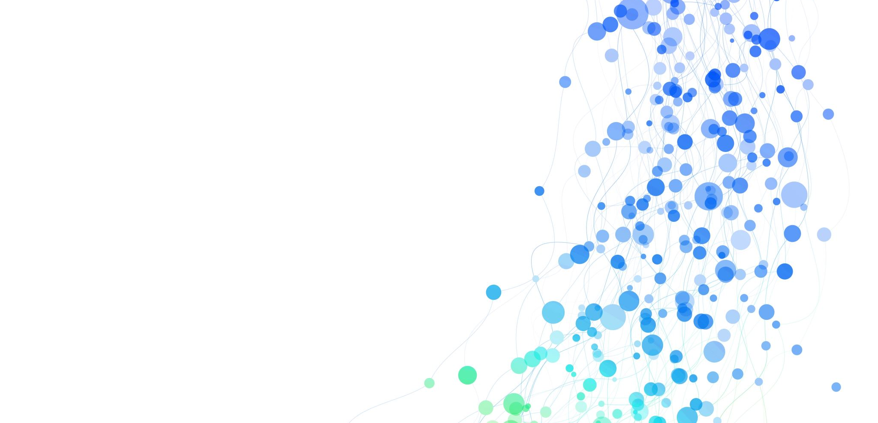
Appendix

Slide 35
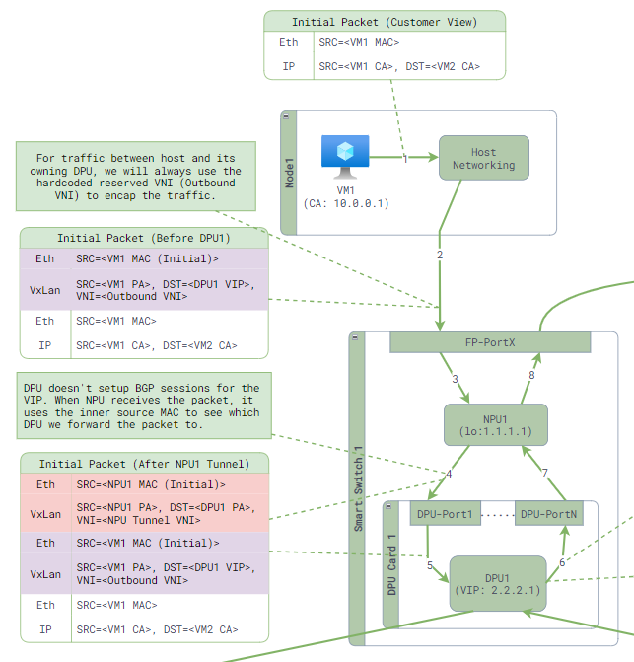
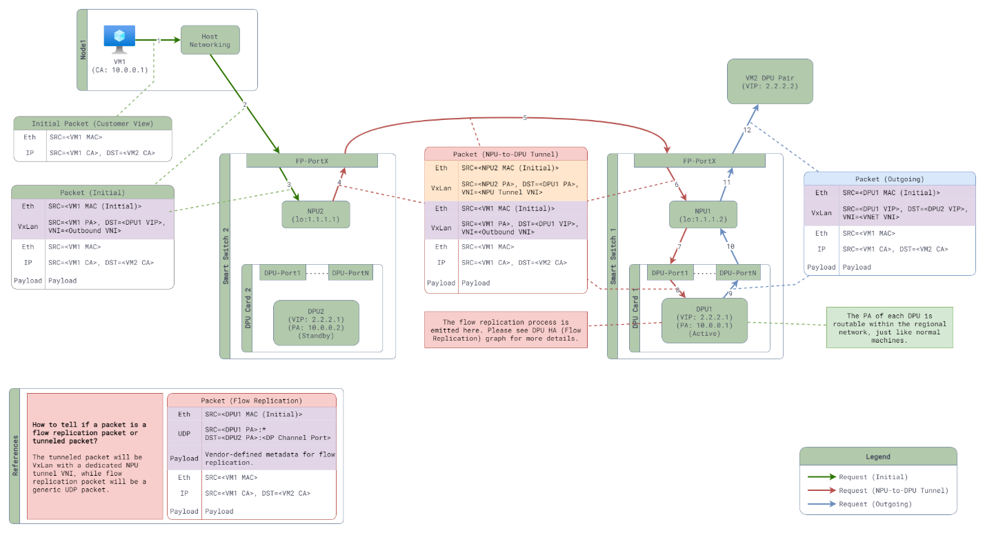
NPU-to-DPU traffic tunneling

Slide 36
State | Definition | Receive traffic from NPU? | Make decision? | Handling old flow? | Respond flow sync? | Init flow sync? | Init Bulk sync?
Dead | HA participant is just getting created, and not connected yet. | No | Drop | Drop | No | No | No
Connecting | Connecting to its peer. | No | Drop | Drop | No | No | No
Connected | Connected to its peer, but starting primary election to join the HA set. | No | Drop | Drop | No | No | No
InitializingToActive | Connected to pair for the first time, voted to be active. | No | Drop | Drop | No | No | No
InitializingToStandby | Connected to pair for the first time, voted to be standby. | No | Tunneled to pair | Tunneled to pair | Yes | No | No
Destroying | Preparing to be destroyed. Waiting for existing traffic to drain out. | No | Tunneled to pair | Tunneled to pair | No | No | No
Active | Connected to pair and act as decision maker. | Yes | Yes | Yes | No | Yes | Yes
Standby | Connected to pair and act as backup flow store. | No | Tunneled to pair | Tunneled to pair | Yes | No | No
Standalone | Heartbeat to pair is lost. Acting like a standalone setup. | Yes | Yes | Yes | Yes | No | No
SwitchingToActive | Connected and preparing to switch over to active. | No | Yes | Yes | Yes | Yes | No
SwitchingToStandby | Connected, leaving active state and preparing to become standby. | Yes | Tunneled to pair | Tunneled to pair | Yes | No | No

